Slide 1
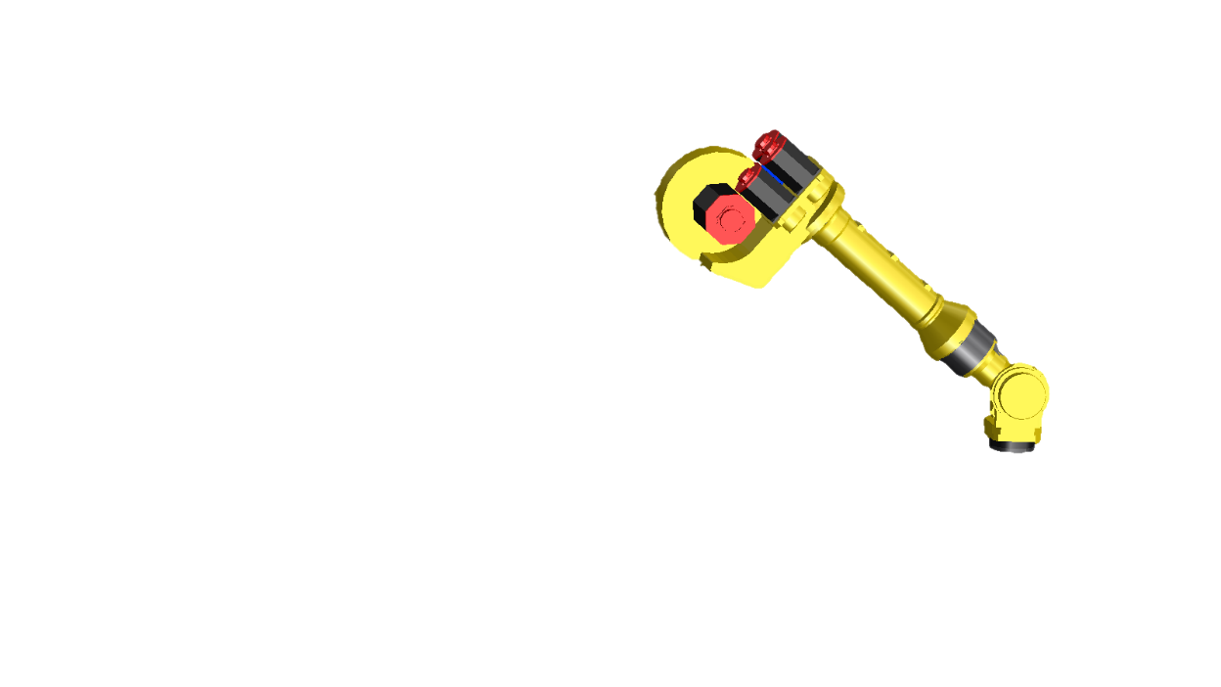
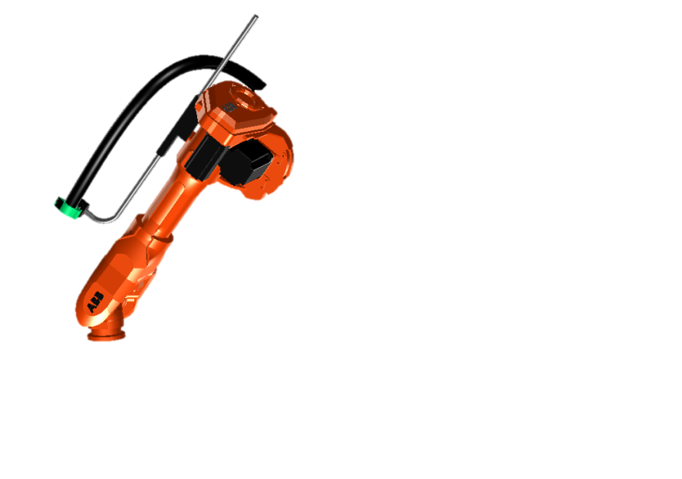
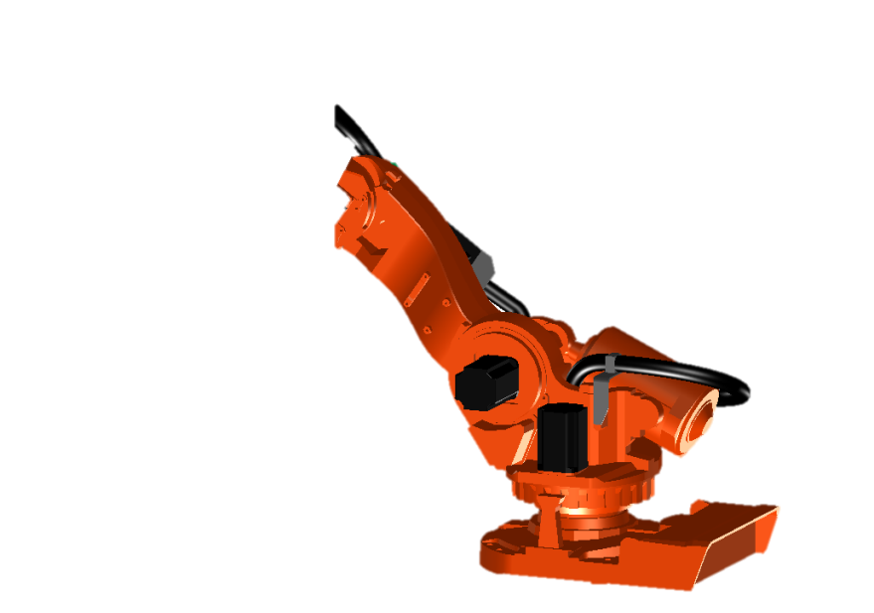
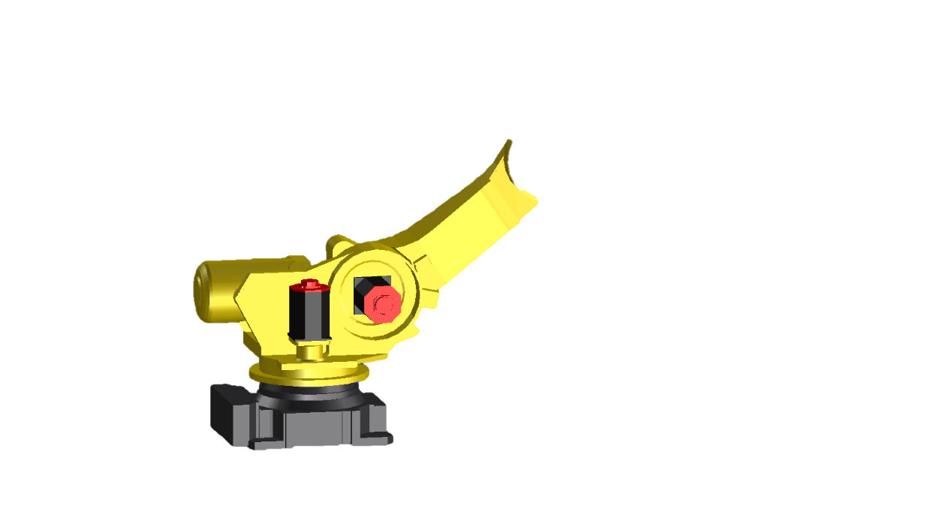
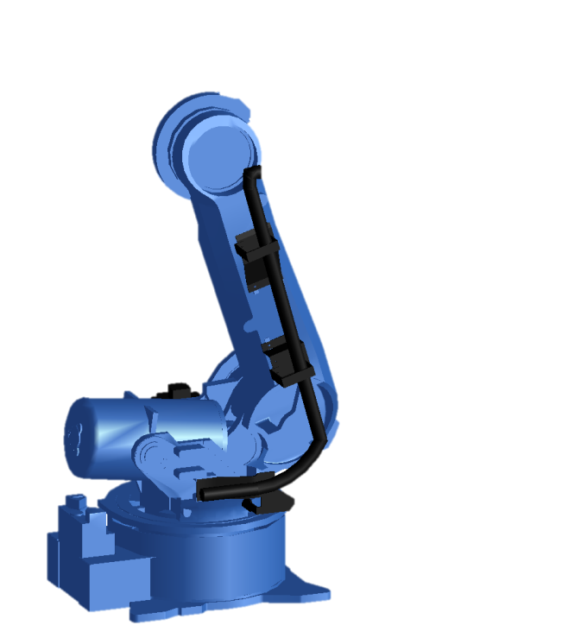
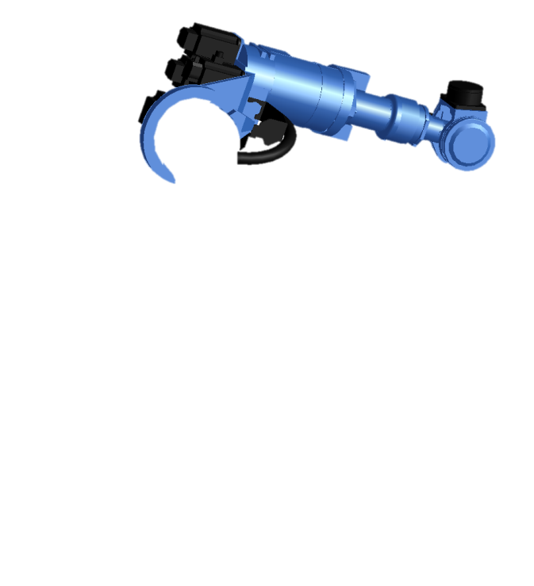
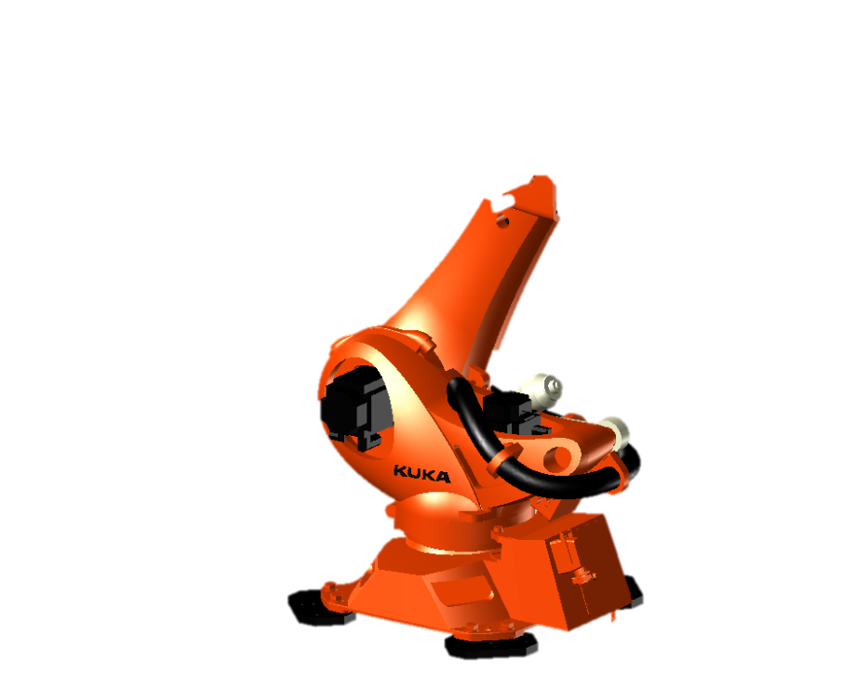
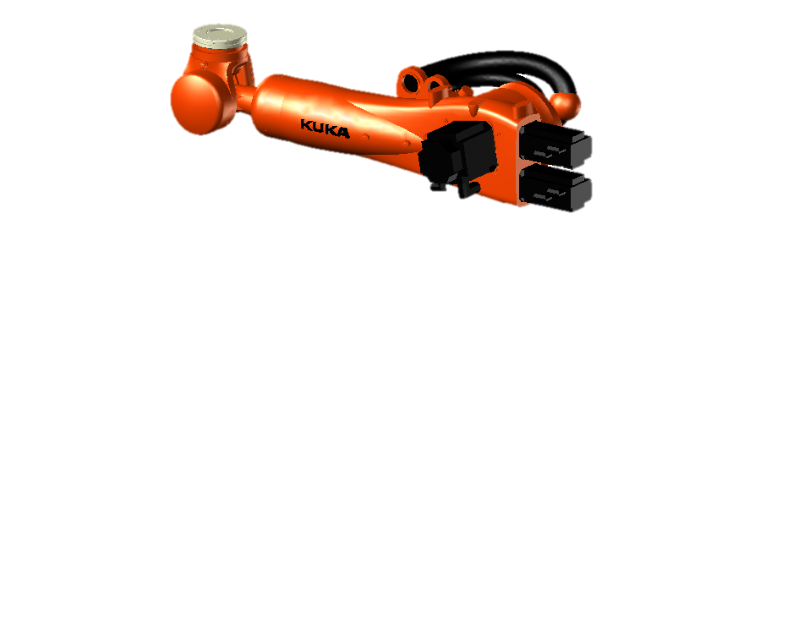
FANUC ROBOT TRAINING
BASIC LEVEL

Slide 2
INDEX
DAY 1
BASIC ROBOTIC CELL
Introduction to Robotics
Types of Robots
MAJOR COMPONENTS OF A ROBOT
Mechanical Manipulator
Robot controller
Teach Pendant
End of arm tooling
SAFETY MEASURES
Safety consideration during teaching
Personal Protective Equipment
SELECTION CRITERIA OF THE ROBOT
Robotic Applications
Payload
Work envelope
Number of axes of Robot
EXERCISE 1
OVERVIEW OF TEACH PENDANT
Function of each keys
LED indicators on Teach Pendant

Slide 3
DAY 2
KNOWLEDGE ON FRAMES
World frame
Tool frame
User frame
EDIT COMMANDS
Usage of all Edit commands
INSTRUCTIONS
Basic instructions
Branch instructions
INFORMATION ON I/O’S
Examples of I/O signals
PRACTICAL 3
JOGGING THE ROBOT
Types of jogging a Robot
Types of operation mode
Sequence for jogging a Robot
PRACTICAL 1
MOTION INSTRUCTION
Types of Interpolations
Motion speeds
Types of Terminations
CREATING PROGRAMS
PRACTICAL 2

Slide 4
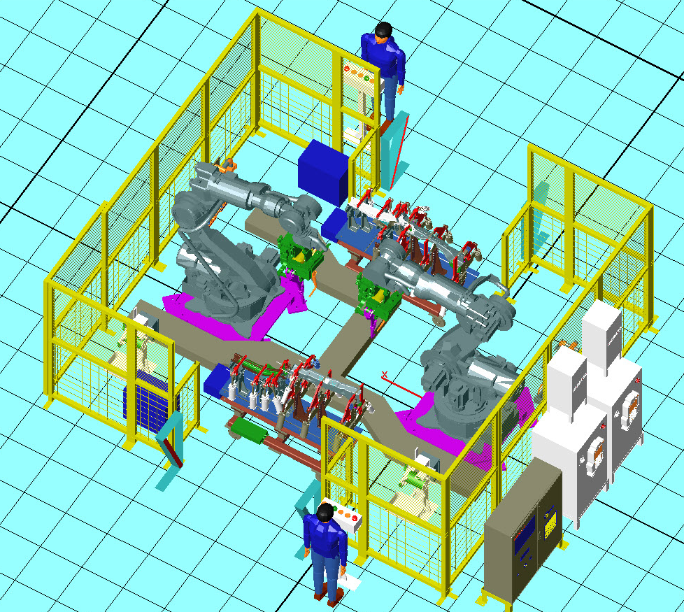
BASIC ROBOTIC CELL
Basic Robotic cell consists of:
A Robot
Its EOAT
Robot Controller
PLC panel
Cable tray
Fences
Fixture/Machine
Components

Slide 5

What is a Robot?
An Industrial robot is a reprogrammable multifunctional assembly of linkages called manipulator, designed to carry out operations through variable programmed motions.

Slide 6
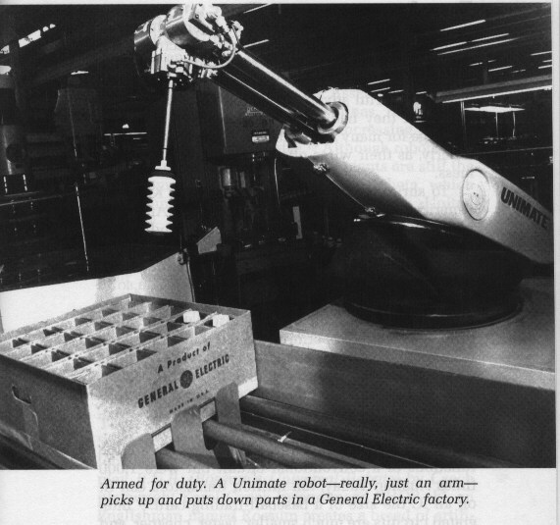
HISTORY OF ROBOTICS
The word "Robot" comes from the Czech word "robota", meaning "forced labor."
The term 'robotics' refers to the study and use of robots. The term was coined and first used by the Russian-born American scientist and writer Isaac Asimov
The first modern industrial robots were probably the “Unimates”, created by George Devol and Joe Engleberger in the 1950's and 60's.

Slide 7
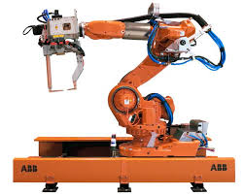
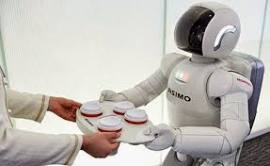
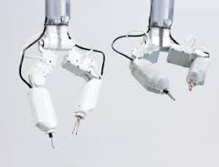
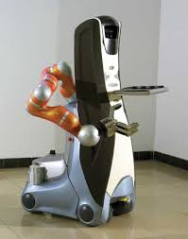
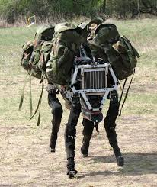

TYPES OF ROBOTS BY FIELD OF APPLICATION
Industrial robots
Domestic robots
Medical robots
Service robots
Military robots
Space robots

Slide 8
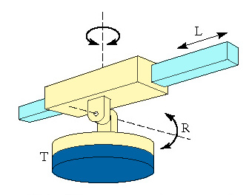
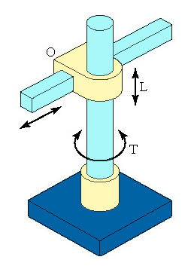
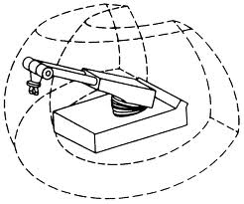
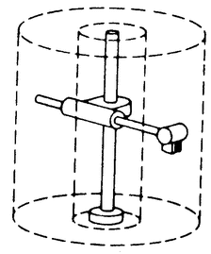
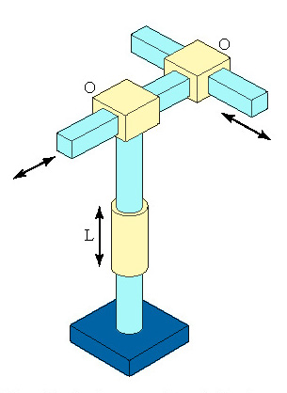
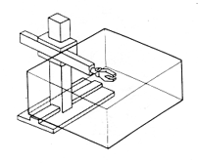
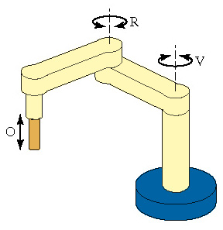
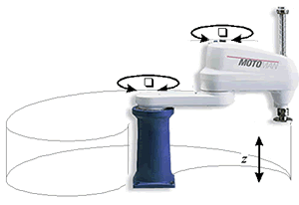
TYPES OF INDUSTRIAL ROBOTS
Polar Coordinate Robot DOF = 3
Cylindrical Robot
DOF = 3
Cartesian/Gantry Robot
DOF = 3
SCARA Robot
DOF = 3

Slide 9
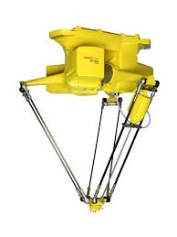
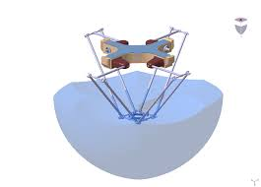
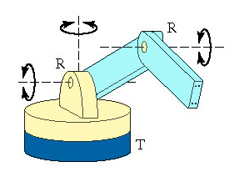
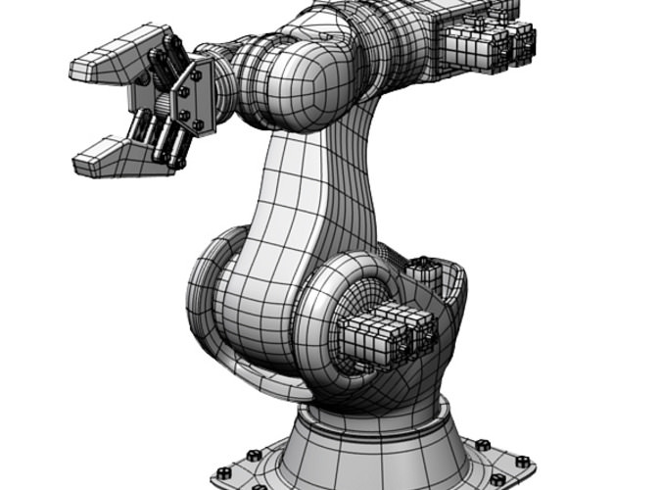
Parallel Robot
DOF = 4
Articulated Robot
DOF = 6

Slide 10
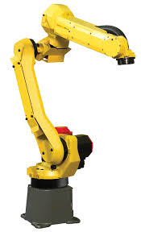
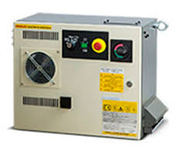
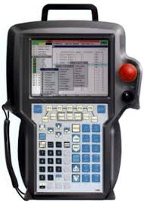
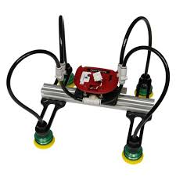
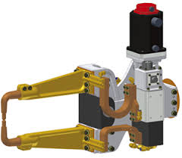
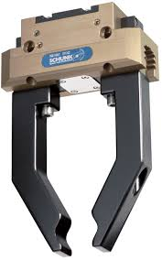
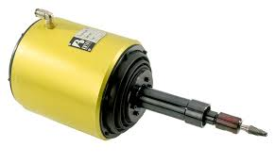
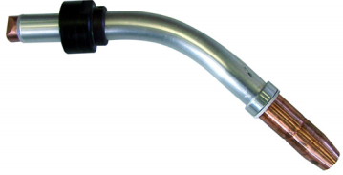
MAJOR COMPONENTS OF A ROBOT
Mechanical Manipulator
Robot Controller
Teach pendent
Various EOATs

Slide 11
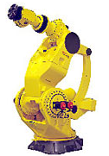
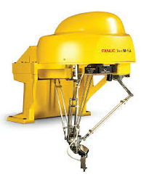
MECHANICAL MANIPULATOR
A manipulator is a mechanical assemblage of rigid links consisting of axis and arms which are driven by servo motors.
When the mechanical linkages are connected in series the linkage is an articulated system

Slide 12
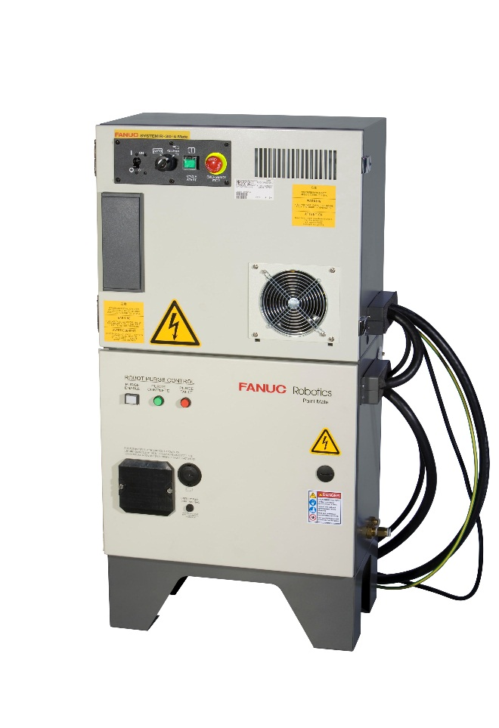
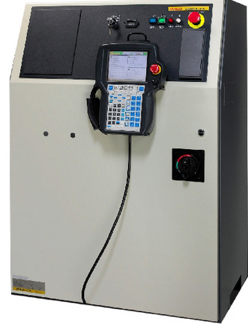

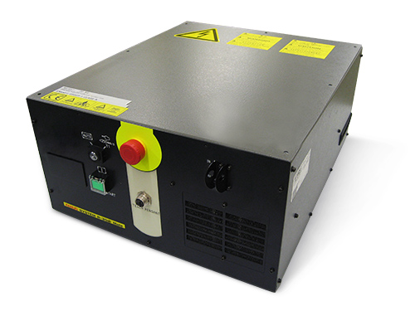
ROBOT CONTROLLER
The Robot controller includes a power supply unit, motion controlling unit, memory circuit, I/O circuit etc.
The motion controlling circuit controls the servo amplifier which moves all the robot axes via the main CPU.
The memory circuit can store programs and data.
The IO circuit interfaces the controller with the peripheral units by receiving and sending signals via the i/o link cable and peripheral connection cable.
RJ-3ib controller
R-30iB mate
R-30iA Paint Mate
R-30iB Open Air Cabinet

Slide 13
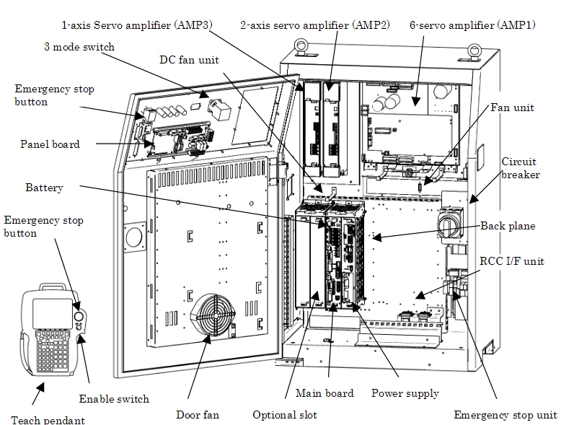
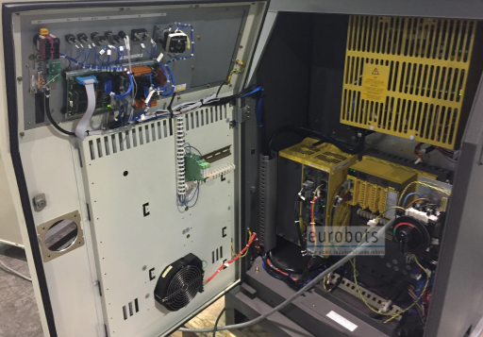

Slide 14
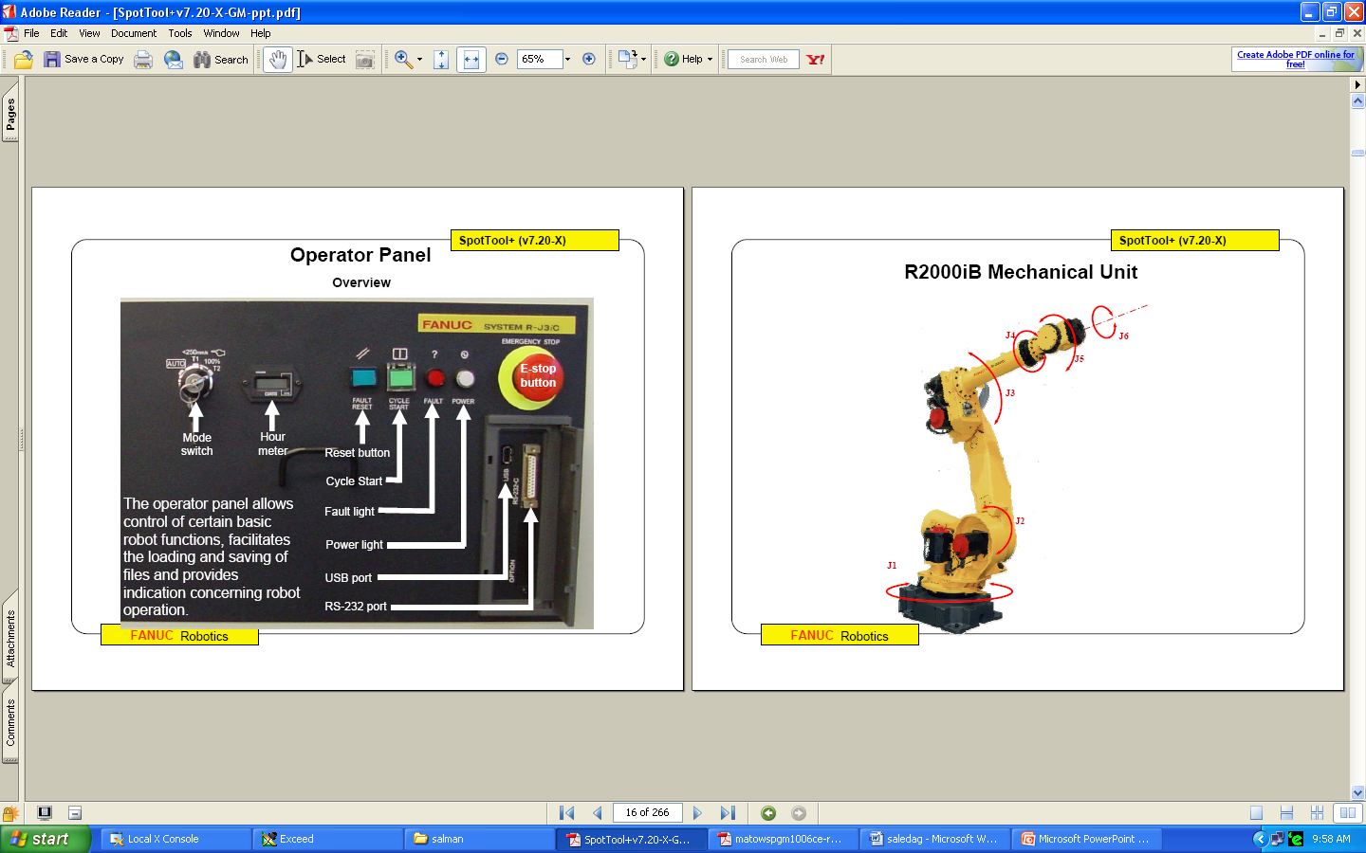
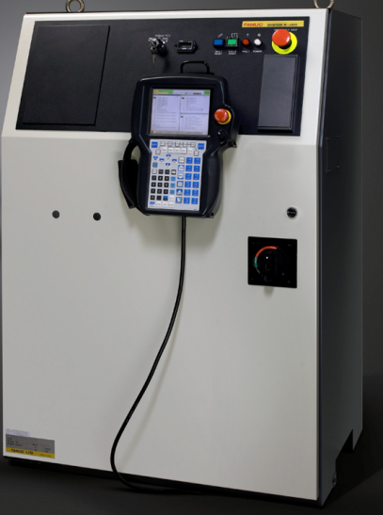


Latest FANUC CONTROLLERS:
RJ3iB (can control up to 16 extended axes)
R30iA (can control up to 40 extended axes)
R30iB (can control up to 72 extended axes)

Slide 15


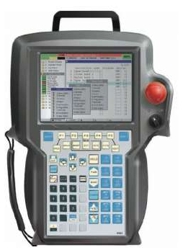
TEACH PENDANT
The Teach Pendant is the interface between the human and the Robot.

Slide 16

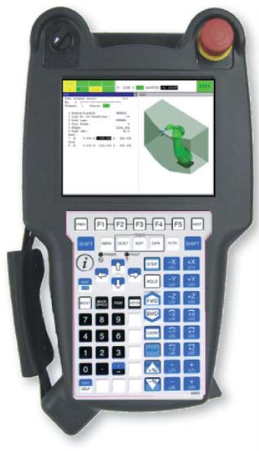
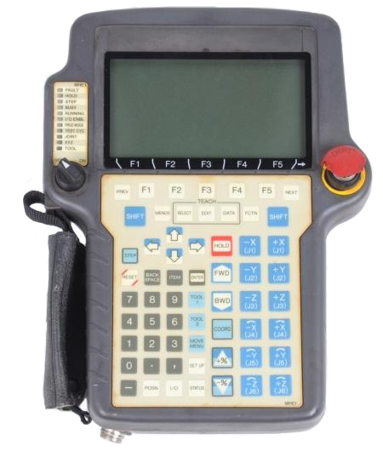


Monochrome
i Pendant
i Pendant Touch
E-stop
Selector switch
Touch display
USB port
E-stop
Selector switch
Touch display
USB port
E-stop
Selector switch
Touch display
USB port

Slide 17
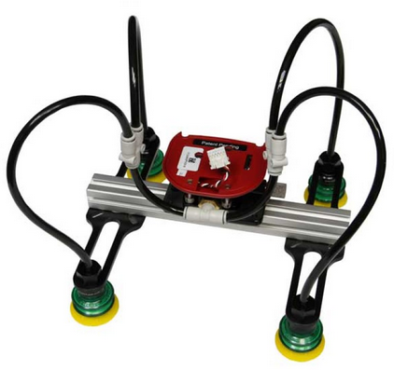
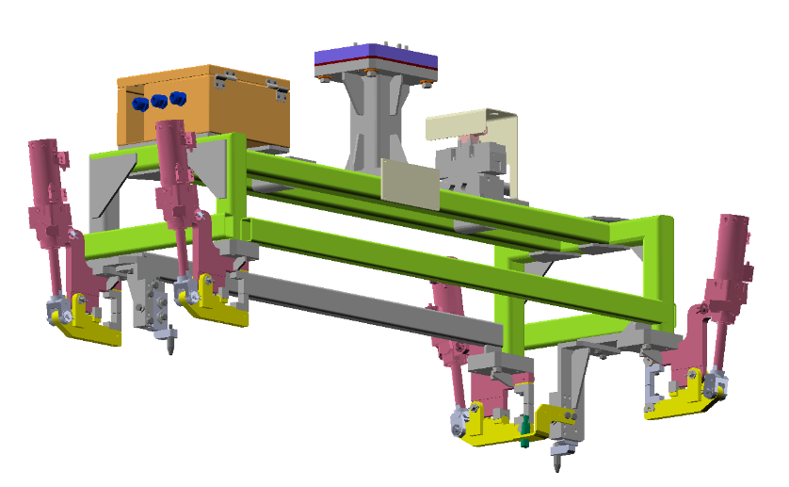
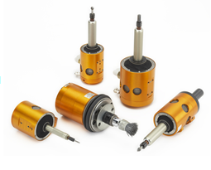


End Of Arm Tooling-EOAT
The tool that is attached to the Tool Mounting Flange of the robot is known as the EOAT .
It may be gripper (vacuum, pneumatic or servo), spot welding gun, arc welding torch, hemming tool, dispenser gun, etc
2 jaw gripper
3 jaw
Vacuum gripper
Customized gripper
Deburring tools

Slide 18










Welding guns
Paint spray guns
Roller hemming tool
Sealing gun
Inspection equipment
Laser cutting tools

Slide 19


Slide 20

SAFETY PRECAUTIONS

Slide 21

PERSONAL PROTECTIVE EQUIPMENTS [PPE]
HELMET
GOGGLES
FACE SHIED
EAR PLUGS
GLOVES AND
ARM SLEEVES
SAFETY SUITS
SAFETY BOOTS

Slide 22
ROBOT SPECIFICATION
SELECTION CRITERIA OF THE ROBOT
Some important specifications to look out for in a Robot:
Application.
Payload
Work envelope.
No. of axes.

Slide 23
APPLICATIONS
Though the robot designs are meant to be used with various applications all robots cannot perform all tasks.
A great care has to be executed while selecting a robot for a particular application. These criteria will enable the robot manufacturer to load the application specific software options & the hardware features while manufacturing the robot.
Welding
Material Handling
Dispensing
Painting
Assembly
Deburring
Palletizing
Pipe bending
Vision tracking
Laser cutting
Inspection and Testing
Hemming

Slide 24





Spot welding
Painting
Collaborative Robot
Heavy duty
Arc welding

Slide 25

WORK ENVELOPE

Slide 26






WORK ENVELOPE
Robots are designed and fabricated with different design configurations and a different number of axes or degrees of freedom. These factors of a robot's design influence its working envelope. The articulated robots are most commonly used in the industries due to their flexibility. The work envelope shape varies from robot model to model.

Slide 27

PAYLOAD
Payload is an important criterion to be considered in the process of the robot selection.
The payload of the robot specifies the maximum weight the robot can handle.
Improper payload selection affects the robot motion performance & results in the shortening the life of the equipment.
The COG of the load attached to the robot flange must be as close to the robot as possible

Slide 28


IMPORTANCE OF PAYLOAD CHART
Payload = Total weight carried by robot at the flange
Payload ≠ only the part weight
Payload = Part + gripper + mounting adaptor weight
Payload is not just the sum of the weights!
What else is Payload?
The Moment & Inertia on the J4, J5 & the J6 axes are important criterion
Be Careful!
The payload charts and allowable
moments are not always defined
from the J6 flange!
This varies from robot to robot.

Slide 29


Slide 30




NUMBER OF AXES
The individual links of each robot manipulator are connected with mechanical joints - each serves as an axis of movement
The number and placement of axes determines the flexibility of each model.
In a 6 axis robot, the first three axes of a robot are known as the major axes because they help in positioning the wrist at a required point on the work piece.
The last three axes of a robot are called as the minor axes because they allow the wrist to reorient in any required direction without changing its position.
4 axis
7 axis
5 axis
6 axis

Slide 31


Slide 32

THE MAJOR AND MINOR AXIS OF ROBOT
The first three axes of a robot are known as the major axes because they help in positioning the wrist at a required point on the work piece.
( J1 , J2 , J3 )
The last three axes of a robot are called as the minor axes because they allow the wrist to reorient in any required direction without changing its position.
( J4 , J5 , J6 )

Slide 33










SOME INDUSTRAIL ROBOT MANUFACTURERS
Fanuc Corp, Japan
Kuka AG, Germany
ABB Ltd, Sweden
Kawasaki Robotics Inc,
Japan
Yaskawa Electric Corp
(Motoman), Japan
Mitsubishi Electric Corp,
Japan
Nachi Fujikoshi Corp,
Japan
Denso Wave Inc,
Japan
Panasonic, Japan
Staubli AG,
Switzerland

Slide 34
EXERCISE
Select a robot for pick and place / material handling application. The robot should pick the component from input conveyor and place it on the output conveyor which is at a distance of approx. 1 m from robot base. Refer the drawing for EOAT details
Adapter plate, 2 kg, dimension as per robot mounting flange
Gripper, 8 kg ,300x200x200
Fingers, 2 kg each, 50x50x200
Component, 10 kg, 150x400
Side view
Front view

Slide 35

OVERVIEW OF TEACH PENDANT
Display Window
Emergency Stop Button
Teach Pendant On/Off selector switch
Key Pad

Slide 36

To jog the Robot Teach Pendant should be On and Press Shift + Jogging Keys.( To run the program in manual mode TP should be On and Press Shift + FWD/BWD keys to execute)
Keys for Jogging in either joint mode or XYZ mode
To execute the program step-by-step
Reset the errors
Selection of Co-ordinates
Short cut to I/O’s
Speed Control keys

Slide 37


Slide 38

LED INDICATION

Slide 39
JOGGING THE ROBOT
Jogging the robot is the operation of moving the robot as desired by manually selecting the axes or direction of motion on the teach pendant.
Two modes of jogging:
Joint jogging
Cartesian jogging

Slide 40

JOINT JOGGING
During joint jog, the robot moves independently around each axis according to each joint coordinate system.

Slide 41

CARTESIAN JOGGING
During Cartesian jog, the tool centre point of the robot moves along the X-, Y-, and Z-axes of the user or jog coordinate systems. You can not cause the robot to rotate the tool around x-,y-,and z-axis of the user frame or jog frame.

Slide 42

TYPES OF OPERATION MODES
T1 (Test mode 1): - Preparation /teaching of job
- Modification of registered job
- Setting of characteristics files & parameters
- Check the program path at low speed
- Program can be executed from the teach pendant only
- Maximum speed is limited to 250 mm/s
T2 (Test mode 2): - Playback of taught job
- Setting , modification or deletion of various condition files
- Program can be executed from the teach pendant only
program can be commanded by external input signal.
- Maximum speed is 100% (2000 - 4000 mm/s depending on Robots)
Auto Mode: - For use during production
- Jogging and executing program through teach pendant is not possible
- Program can be executed from external devices and operator’s panel
- Maximum speed is 100%

Slide 43






SEQUENCE FOR JOGGING A ROBOT
1.Enable the teach pendant.
2.Depress the Deadman Switch.
3.Reset the displayed errors.
4.Select the required coordinate
system.
5.Select the required speed.
6. Finally, press both “Shift” and the required “Axes jog” key, to jog the robot.

Slide 44
PRACTICAL 1
Inspecting the manipulator, controller, teach pendant and connections.
See the axis of the robot.
What is the name of Fanuc model?
What is the name of the controller?
What is I/P power supply to controller
Go through its ORDER no.( see whether the controller order no. and robot order no is matching.)
Go through the connections at the robot base.
Go through the axis scale for all joints on robot.
Inspect the motors mounted on the robot for each axis.
See the controller’s cable connections to robot.
See the connection for TP from the controller.
See how to switch ON/OFF the controller.
See what are the buttons present on the controller.
Inspect how the other connections has been made.
Jog the axis of the robot in different speeds.
Draw a neat sketch of the controller indicating all the parts
Draw a neat sketch of the teach pendant.

Slide 45

MOTION INSTRUCTION
ADVANCE
INSTRUCTIONS
1. J P[1] 100% FINE
2. J P[2] 100% CNT 20
3. L P[3] 1500mm/sec FINE
4. L P[4] 2000mm/sec FINE
5. C P[5]
P[6] 100mm/sec FINE

Slide 46
TYPES OF INTERPOLATION
Interpolation type determines the path along which the manipulator moves between playback steps. There are 3 types of interpolation in Fanuc;
JOINT INTERPOLATION
LINEAR INTERPOLATION
CIRCULAR INTERPOLATION

Slide 47

JOINT INTERPOLATION
This interpolation is used when the robot does not need to move in a specific path towards the next step position. Robots takes the quickest path.
1: J P[1] 100% FINE
2: J P[2] 100% FINE

Slide 48


LINEAR INTERPOLATION
The manipulator moves in a linear path (as shown in the fig.)from one taught step to the next. Robot takes the shortest path.
1: J P[1] 100% FINE
2: L P[2] 2000mm/sec FINE

Slide 49

CIRCULAR INTERPOLATION
The manipulator moves in a circular path from start point to end point through the center point
Center point
P[2]
Start point
End point
P[1]
P[3]
1: J P[1] 100% FINE
2: C P[2]
: P[3] 2000mm/sec FINE

Slide 50


Slide 51
MOTION SPEEDS
Speed in a motion instruction, determines how fast or slow the manipulator moves to execute the programmed motion. This speed can be defined in different forms, as required by the programmer.
Some of the common forms of expressing speed in a motion instruction, on a FANUC robot are given below:
mm/sec.
cm/min.
inch/min.
deg/sec.
sec.
msec.
In the first 3 options, the user can specify the speed in mm/cm/deg per min, for instance,
2000 mm/sec
15000 cm/min
5000 inch/min
360 deg/sec and so on..
Where as, in the last 2 options, the user defines the speed w.r.t the time taken to move from Point A to Point B. For example,
3sec
500msec

Slide 52

TYPES OF TERMINATIONS

Slide 53




CREATING PROGRAMS
Steps :-
Press Select
Press on {Create} F2
Give Program Name
Fill the below list as per requirement.
Press {End} F1
Now Start Programming
Note :- To record the points Press Shift + Point.

Slide 54


Slide 55


SEQUENCE FOR MANUALLY EXECUTING A PROGRAM
1.Enable the teach pendant.
2. Select the program
3.Depress the Deadman Switch.
4.Reset the displayed errors.
5.Select the required speed.
6.Execute the program by pressing shift + FWD key
Note: 1: Check the program cursor position and select the required line before executing.
2: Make sure no personnel is present around the Robot and follow safety precautions before moving the Robot.

Slide 56
PRACTICAL 2
Write a program to trace a square
Write a program to trace a circle
Write a program to trace a hexagon
Write a program to trace a rectangle
Write a program to trace a hexagon inscribed in a circle
Write a program to trace a square inscribed in a circle

Slide 57
DAY 2
KNOWLEDGE ON FRAMES
EDIT COMMANDS
BRANCH INSTRUCTIONS
INFO ON I/O’S
PRACTICAL 3
TEST & EVALUATION
DOUBTS & CLARIFICATION

Slide 58
FRAMES RELATED TO ROBOT
World Frame :- The default frame of the Robot which is non-editable.
Tool Frame :- Can be defined by the User. (Default TF = 0 is non-editable)
User Frame :- Can be defined by the User. (Default UF = 0 is non-editable)
Jog Frame :- Can be defined by the User.
Note :-. All points are recorded with respect to the Tool frame and User frame but not the Jog Frame, which is only used for jogging.

Slide 59

WORLD FRAME
World Frame :- The default frame is the origin of the Robot which is predefined by the manufacturer. This is nothing but the (0,0,0,0,0,0). This origin of the robot that acts as a reference frame for the User frame and Jog frame.

Slide 60




TOOL FRAME
Tool Frame :- The default tool frame is located at robot’s J6 Flange center. This is the default tool frame which is a Cartesian co-ordinate system and is known as Tool Center Point (TCP).
Tool Frame at desired EOAT position depending on the type of tool
Default Tool Frame at J6 Flange center

Slide 61

USER FRAME
User Frame :- The user frame by default has world frame as its reference. When the user frame is setup, all the positions are automatically recorded in the user frame in the program. User frame is setup so that its easy for the programmer to program with respect to the defined user frame and it eases re-teaching when the object is shifted without actually teaching all points. Up to 10 numbers of user frame can be set up.

Slide 62



Coordinates of the point from user frame.
P[1]
USER FRAME
P[1]
P[2]
USER FRAME
P[2]

Slide 63

CONFIGURATION
SINGULARITY ERROR

Slide 64


NO FLIP (N)
FLIP (F)
J1 = 0 , J2 = 0 , J3 = 0 , J4 = 0 , J5 = -90, J6 = 0
J1 = 0 , J2 = 0 , J3 = 0 , J4 = 179 , J5 = 90, J6 = 179

Slide 65


UP (U)
DOWN (D)

Slide 66


TOP (T)
BOTTOM (B)

Slide 67

EDIT COMMANDS
INSERT :- To Insert lines
DELETE :- To delete a single or many lines
COPY :- To copy lines
FIND :- To look for some instructions, I/O’s etc.
REPLACE :- To replace some instructions
RENUMBER :- To renumber all the Positions
COMMENT :- To hide or unhide the comments associated with each points or I/O’s.
UNDO :- Can only be used once.

Slide 68
1: L P[1] 2000mm/sec FINE
2: L P[2] 2000mm/sec FINE
3: L P[3] 2000mm/sec FINE
4: L P[4] 2000mm/sec FINE
1: L P[1] 2000mm/sec FINE
2: L P[2] 2000mm/sec FINE
3: L P[3] 2000mm/sec FINE
4: L P[4] 2000mm/sec FINE
PRESS “F5” <<EDCMD>> INSERT
HOW MANY LINES TO INSERT?
1.
PRESS “F5” <<EDCMD>> DELETE
DELETE LINE(S)?
YES.
1: L P[1] 2000mm/sec FINE
2: L P[3] 2000mm/sec FINE
3: L P[4] 2000mm/sec FINE
PRESS “F5” <<EDCMD>> RENUMBER
RENUMBER OK?
YES.

Slide 69
INSTRUCTIONS
REGISTERS :- Used for storing any values
I/O :- Contains all types of I/O’s
IF SELECT :- Condition Instructions
WAIT :- To wait for some condition
JUMP LABEL :- Branching Instruction
CALL :- To call a program or a macro
MISCELLENOUS
RSR
UALM
TIMER
OVER RIDE

Slide 70



Slide 71

DATA

Slide 72
BRANCH INSTRUCTIONS
A branch instruction causes a branch from one line of a program to another.
Four types of branch instructions are supported.
• LABEL instruction
• Program END instruction
• Unconditional branch instruction
• Conditional branch instruction
An unconditional branch instruction invariably causes a branch from one line to another in the same program.
Two types of unconditional branch instructions are supported.
• JUMP instruction: Causes a branch to a specified label or program.
• Program CALL instruction: Causes a branch to another program.

Slide 73
A conditional branch instruction causes a branch from one location in a program to another when some condition is satisfied.
Two types of conditional branch instructions are available.
• IF instruction: Causes a branch to a specified label or program when some condition is satisfied.
• SELECT instruction: Causes a branch to a specified jump instruction or subprogram call instruction according to the value of a register.

Slide 74
SAMPLE PROGRAMS
Unconditional loop
1: JMP LBL[1]
2: L P[1] 2000mm/sec FINE
3: L P[2] 2000mm/sec FINE
4: LBL[1]
END
Call instruction
1: L P[1] 2000mm/sec FINE
2: L P[2] 2000mm/sec FINE
3: CALL xxx
END
1: TIMER[1]=RESET
2: TIMER[1]=START
3: LBL[1]
4: R[1]=R[1]+1
5: L P[1] 2000mm/sec FINE
6: SELECT R[1] = 1, JMP LBL[1]
7: = 2, CALL xxx
8: ELSE, JMP LBL[99]
9: TIMER[1]=STOP
10: LBL[99]
END
Conditional loop
1: R[1]=0
2: LBL[1]
3: R[1]=R[1]+1
4: L P[1] 2000mm/sec FINE
5: L P[2] 2000mm/sec FINE
6: IF R[1]<6 JMP LBL[1]
END

Slide 75

SKIP CONIDITION

Slide 76

EXERCISE

Slide 77
I/O’S
Input/output signals (I/O) are electric signals that allow the controller to communicate with the robot,
end effector, external equipment, and other peripheral equipment of the system.
The signals are divided into two groups:
General-purpose I/O
The user can define the general-purpose I/O as required.
This group includes the following signals:
• Digital I/O: DI[i]/DO[i]
• Group I/O: GI[i]/GO[i]
• Analog I/O: AI[i]/AO[i]
Specialized I/O
The use of the specialized I/O has already been defined.
This group includes the following signals:
• Peripheral (UOP) I/O: UI[i]/UO[i]
• Operator's panel (SOP) I/O: SI[i]/SO[i]
• Robot I/O: RI[i]/RO[i]
[i] represents the logic number of each I/O signal and group signal.

Slide 78
I/O’S
Example of input signals
Proximity switch
Limit switch
Reed switch
Light curtains
Example of output signals
Solenoid operations
GRIPPER ON/OFF

Slide 79
I/O Concepts
DO[1]
24V
0V

Slide 80



INPUT AND OUTPUT SIGNALS
Input signals
Output signals

Slide 81
SAMPLE PROGRAM WITH INPUT AND OUTPUT SIGNALS
1: L P[1] 2000mm/sec CNT100
2: L P[2] 100mm/sec FINE
3: WAIT DI[1:Proximity]=ON
4: DO[1:Clamp close]=ON
5: WAIT DI[2:Reed switch]=ON
6: L P[3] 100mm/sec FINE

Slide 82


Slide 83

I/O’s

Slide 84
PRACTICAL 3
Write a program to trace a square by teaching a single corner in position register and entering the dimension of the side in register. Check the cycle time of your program using TIMER[1]
Write a program trace a circle by teaching the circle center in position register and entering the radius in register. Check the cycle time of your program using TIMER[2]
Write a program to call each of the above in a single program
Write a program to run the square program for 5 cycles and circle program for 2 cycles
Write a program trace an equilateral triangle by teaching one corner of the triangle and entering the dimensions of the side in a register.

Slide 85

Questions

Slide 86

THANK YOU

